Slide 1
What is a medical image analysis paper accepted by CVPR like?
Minqing Zhang
2020/05/08

Slide 2
Challenges in Medical Image Analysis
Data are not that abundant while labeled data are more rare.
Lesions are usually hard to be distinguished.
Performance is expected to be perfect because it is about human health.

Slide 3
What is a medical image analysis paper accepted by CVPR look like?
Propose a novel application with clinical significance and investigate it comprehensively.
Design novel methods which alleviate a general issue plaguing the MIA domain and outperform previous methods.

Slide 4
CVPR paper list
Holistic and Comprehensive Annotation of Clinically Significant Findings on Diverse CT Images: Learning from Radiology Reports and Label Ontology
Data augmentation using learned transformations for one-shot medical image segmentation

Slide 6
Motivation
The existing studies on computer-aided diagnosis (CAD) usually focus on certain body parts (lung, breast, liver, etc.) and attempt to distinguish between a limited set of labels.
We aim to develop a new framework to predict these semantic labels holistically (jointly learning all labels), so as to go one step closer to the goal of “learning to read CT images”.
Existing lesion datasets are typically either too small or less diverse. Fortunately, the recently-released DeepLesion dataset has largely mitigated this limitation.

Slide 7
Dataset - DeepLesion
It contains bounding boxes of over 32K lesions from a variety of body parts on CT images.
However, there are no fine-grained semantic labels given for each lesion in DeepLesion.
In the course of interpreting a CT scan, a radiologist may manually annotate a lesion in the image, and place a hyperlink to the annotation (a “bookmark”) in the report.

Slide 8
Challenges
Radiology reports are often in the format of free-text, so extracted labels can be noisy and incomplete.
Some labels are difficult to distinguish, e.g. adjacent body parts, similar types, and subtle attributes.
The labels are highly imbalanced and long-tailed.

Slide 9
Contribution
We study the holistic lesion annotation problem and propose an learning framework with minimum manual annotation effort.
An algorithm is proposed to text-mine relevant labels from radiology reports.
We present an effective lesion annotation algorithm (LesaNet).
To leverage the ontology-based medical knowledge, we incorporate label relations in LesaNet.

Slide 10
Method
We propose LESion Annotation Network (LesaNet) to predict fine-grained labels to describe diverse lesions on CT images. The training labels are text-mined from radiology reports. Label relations are utilized in learning.

Slide 11
Method – Ontology construction
Construct 3 genres of label
Types (coarse -> fine-grained): nodule -> lung nodule
Body parts (coarse -> fine-grained): chest -> lung
Attributes (shape, size, intensity): hypodense, large).

Slide 12
Method – Label extraction
Lesion bounding boxes -> hyperlinks -> sentences in the report
NLTK -> words -> label matching (synonyms)
Radiology reports are in the format of free-text -> extracted labels can be noisy
A text-mining module [1] can help clean the extracted labels
Input: the word sequence with mentioned labels and bookmarks, and the sentence embedding.
Output: a probability vector corresponding to the type of the relation between the label and the bookmark (irrelevant, uncertain, and relevant).
[1] A self-attention based deep learning method for lesion attribute detection from CT reports

Slide 13
Method – LesaNet
Multi-scale VGG-16 backbone: body parts require high-level contextual features while many attributes depict low-level details.

Slide 14
Method – LesaNet
Loss:

Slide 15
Method – LesaNet
Label expansion: If a child label is true, all its parents should also be true.

Slide 16
Method – LesaNet
RHEM: , the higher is, the more times it will be sampled.

Slide 17
Method – LesaNet
SPL: a simple FC layer that refines the predicted scores with a linear transformation matrix W; learn to capture the relation between labels. improve recall & interpretability

Slide 18
Method – LesaNet
Metric learning:
similarity
Multilabel triplet loss

Slide 19
Implementation
DeepLesion
Training: 19,213, Validation: 1,852, Test: 1,759.
Resulting in 171 unique labels (115 body parts, 27 types, and 29 attributes).
Manually obtained 137 parent-child pairs and 4,461 exclusive pairs.
Two radiologists further manually annotated 500 random lesions in the test set in a more comprehensive fashion. (An average of 1.2 labels are missing in each bookmarked sentence.)
Network
Input: 120x120x3 patch cropped around the lesion.

Slide 20
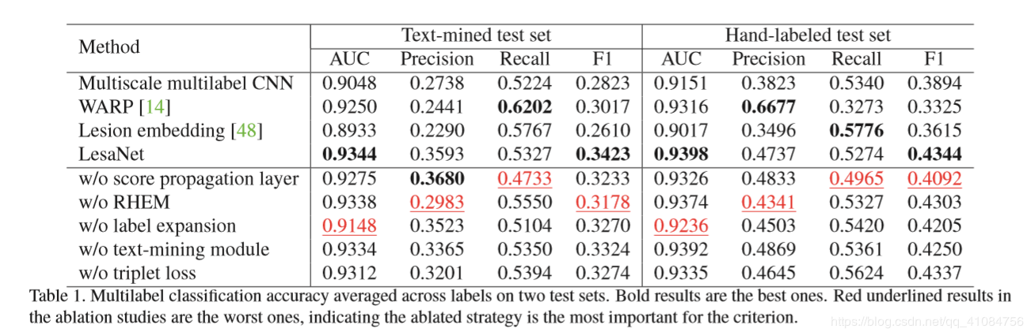
Lesion Annotation Results
F1 scores are relatively low
Class highly imbalanced: 78 labels have fewer than 10 positive cases.
Training set still suffers from noisy labels.

Slide 21
Lesion Annotation Results
The visual feature of some labels (e.g., paraspinal, nodule) is variable, thus harder to learn.
Besides, radiologists typically do not describe every attribute of a lesion in the report, thus there are missing annotations in the test set.
胸部
肺部
肝脏
淋巴结
肾上腺
右中肺
胰腺尾
脊椎旁
结节
囊肿
腺瘤
转移
低密度硬化
空洞
大

Slide 22
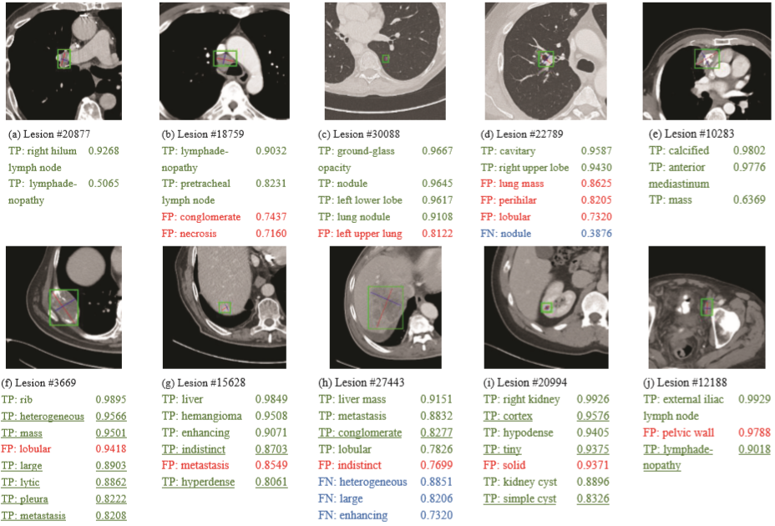
Lesion Annotation Results

Slide 23
Lesion Annotation Results
Removing SPL decreased the average per-class recall by 3%. Among it, the recall of frequent labels (ntr > 1000) only decreased 0.4%, showing that SPL is important for the recall of rare labels.

Slide 24
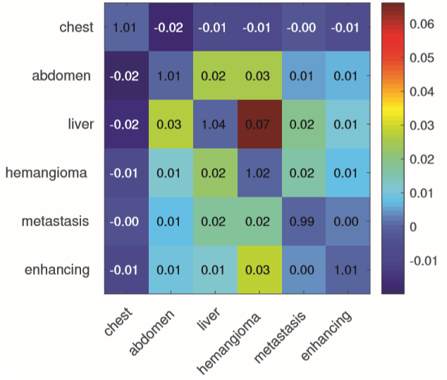
Lesion Annotation Results
We can find that W(liver, hemangioma)
is high, while W(chest, abdomen)
is low.

Slide 25
Conclusion
We studied the holistic lesion annotation problem, and proposed a framework to automatically learn clinically meaningful labels from radiology reports and label ontology.
A lesion annotation network was proposed with effective strategies that can both improve the accuracy and bring insights and interpretations.

Slide 27
Motivation
Neural networks typically rely on supervised training with large labeled datasets. Labeling medical images requires significant expertise and time.
The typical hand-tuned approaches for data augmentation fail to capture the complex variations in such images, and can be highly sensitive to the choice of parameters.

Slide 28
Examples
Biomedical images often vary widely in anatomy, contrast and texture (top row).

Slide 29
Contribution
We present an automated data augmentation method for synthesizing labeled medical images.
We learn a model of transformations from the images, and use the model along with the labeled example to synthesize additional labeled examples.
We show that training a supervised model with these new examples provides significant improvements over state-of-the-art methods for one-shot biomedical image segmentation.

Slide 30
Method
One-shot: only one labeled atlas is available.
Separately learn the spatial and intensity transformations between the labeled atlas and the unlabeled scans.
Using the atlas, the learned transformations, and unlabeled scans, labeled synthesized scans can be obtained.

Slide 31
Method

Slide 32
Method - Spatial and appearance transform models
x – the atlas scan; y – the unlabeled scans
Learn the spatial and appearance transformation using CNN

Slide 33
Method - Spatial and appearance transform models

Slide 34
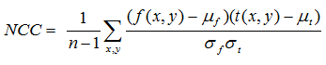
Method - Spatial transform models
Input: x cat y (HxWxDx2)
Output: deformation field (HxWxDx3), 3 -> x, y, z
Loss: similarity loss + smoothness term
Similarity loss: normalized cross-correlation
smoothness term: , is the binary edge of the label of the atlas scan, is the spatial gradient operator

Slide 35
Method - Appearance transform models
Input: x cat y (HxWxDx2)
Output: deformation field (HxWxDx1), 1 -> intensity
Loss: similarity loss + smoothness term
Similarity loss: L2 loss
smoothness term: , is the binary edge of the label of the atlas scan, is the spatial gradient operator

Slide 36
Synthesizing new examples
Since the spatial and appearance targets can be different subjects, our method can combine the spatial variations of one subject with the intensities of another.

Slide 37
Dataset
We use the publicly available dataset of T1-weighted MRI brain scans. The scans are compiled from eight databases.
We resample the brains to 256x256x256 with 1mm isotropic voxels, and affinely align and crop the images to 160x192x224.
30 anatomical structures to be segmented.
Training set: 1 atlas scan + 100 unlabeled scans
Validation set: 50 scans
Test set: 100 scans

Slide 38
Baseline models
Single-atlas segmentation (SAS): for each test image , we compute the spatial transform field , and predict label .
Data augmentation using single-atlas segmentation (SAS-aug): We use SAS results as labels for the unannotated training brains.

Slide 39
Baseline models
Hand-tuned random data augmentation (rand-aug): We create random smooth deformation fields, and then applying bilinear interpolation and spatial blurring.
Supervised: We train a fully-supervised segmentation network that uses ground truth labels for all 101 examples in our training dataset. This method serves as an upper bound.

Slide 40
Proposed models
Independent sampling (ours-indep): we sample spatial and appearance target images independently to synthesize 10,000 new examples to the training set.
Coupled sampling (ours-coupled): we sample paired spatial and appearance target images to synthesize 100 new examples to the training set.
Ours-indep + rand-aug: we alternate between examples synthesized using ours-indep, and examples synthesized using rand-aug.

Slide 41
Results

Slide 42
Results

Slide 43
Results

Slide 44
Results

Slide 45
Conclusion
Learning independent models of spatial and appearance transformations enables the synthesis of diverse and realistic labeled examples.
The synthesized examples can be used to train a segmentation model that out-performs existing methods in a one-shot scenario.

Slide 46
Thanks

